Slide 1
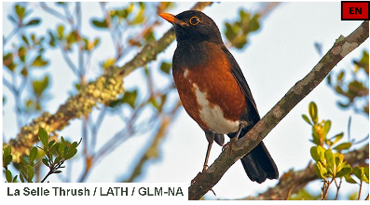
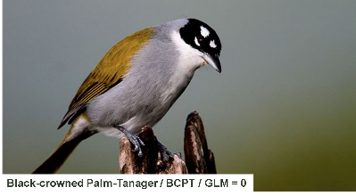
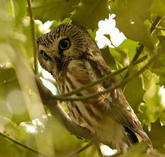
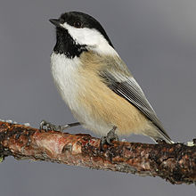
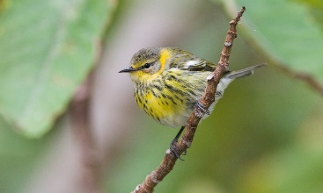
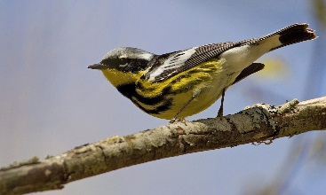
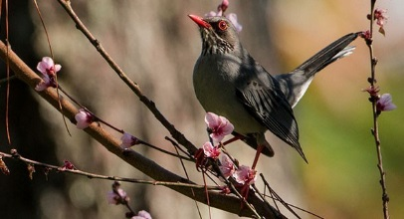
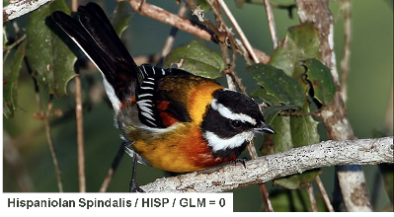
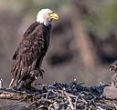
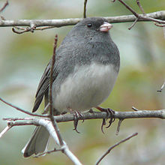
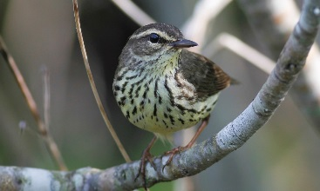
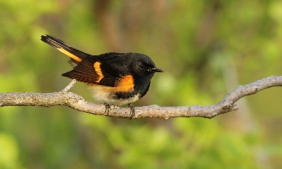
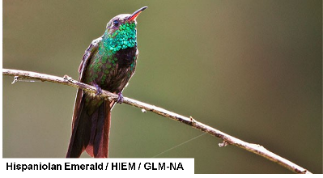
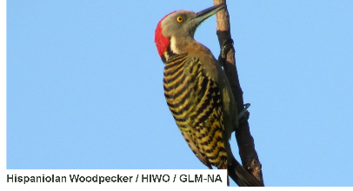
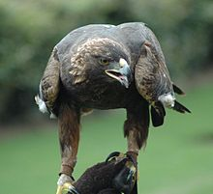
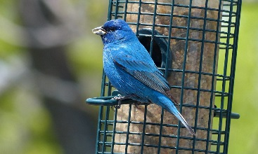
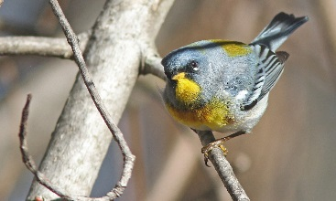
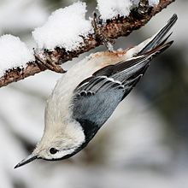
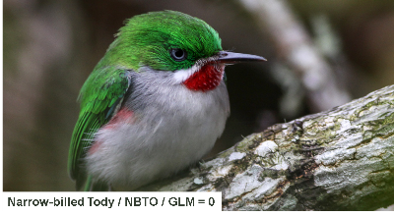
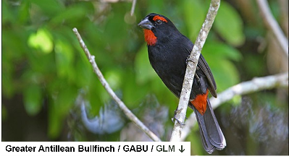
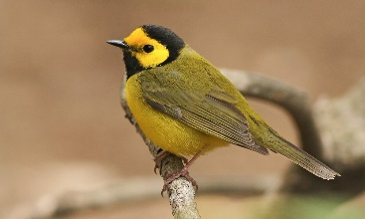
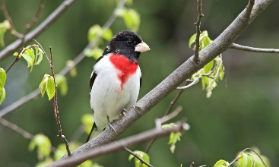
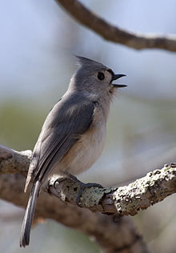
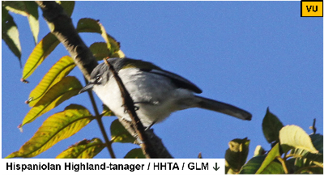
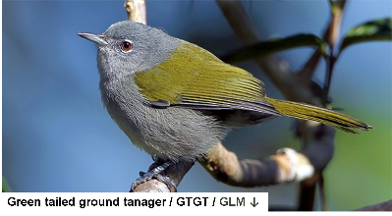
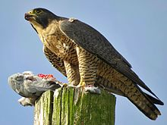
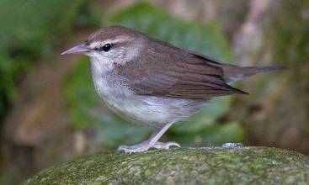
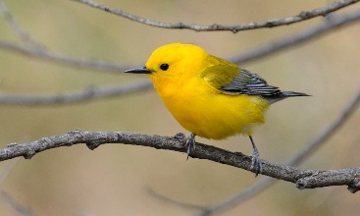
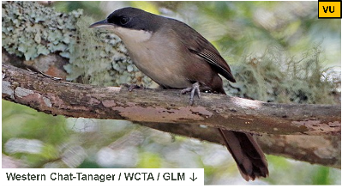
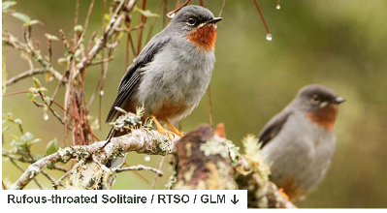
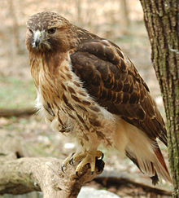
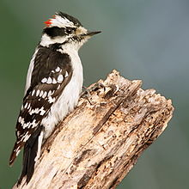
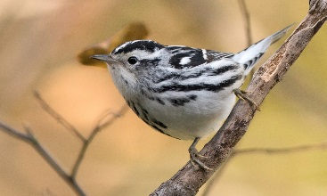
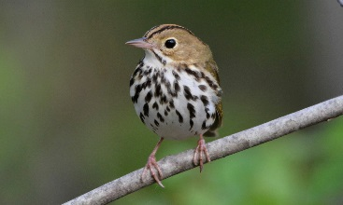
Introduction to Avian Ecology & the “Wild Bird Project”
Nathan Brouwer, PhD
La Roche University &
National Aviary

Slide 2
Lecture outline
1) Birds!
resident vs. migrants
2) Bird habitat:
nesting, breeding, wintering
3) Damage to bird habitat:
degradation, fragmentation, loss
4) Bird Predators:
Nest predation vs. “on the wing”
Habitat fragmentation & nest predation
Native & Introduced (cats!)
5) Bird Diseases:
Pathogens, parasites & zooenoses
Parasites & Habitat framentation
Parasites & predation
Other hazards:
windows & windfarms

Slide 3
1)Birds!

Slide 4
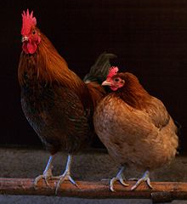
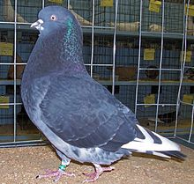
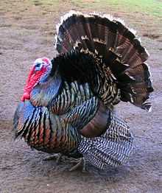
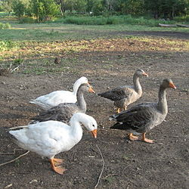
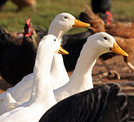
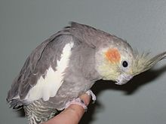
Birds!
Domestic Birds
Wild Birds

Slide 5
Birds!
Domestic Birds
Wild Birds

Slide 6
Birds!
Domestic Birds
Wild Birds

Slide 7
Wild Birds!
Residents
Stay in about the same place all year
Migrants
Move between breeding habitat & wintering habitat

Slide 8
Wild Birds!
Residents
Stay in about the same place all year
Migrants
Move between breeding habitat & wintering habitat

Slide 9
Wild Birds!
Residents
Stay in about the same place all year
Migrants
Move between breeding habitat & wintering habitat

Slide 10
Wild Birds!
Residents
Stay in about the same place all year
Migrants
Move between breeding habitat & wintering habitat

Slide 11
Migrant Birds!
Short- to medium-Distance migrants
Move around on the same continent
Long-distance migrants
Move between continents / l&masses

Slide 12
Migrant Birds!
Short- to medium-Distance migrants
Move around on the same continent
Long-distance migrants
Move between continents / l&masses

Slide 13
Migrant Birds!
Short- to medium-Distance migrants
Move around on the same continent
Long-distance migrants
Move between continents / l&masses

Slide 14
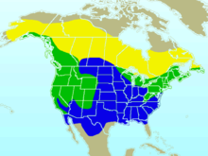
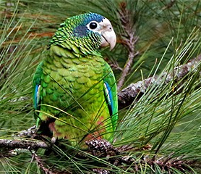
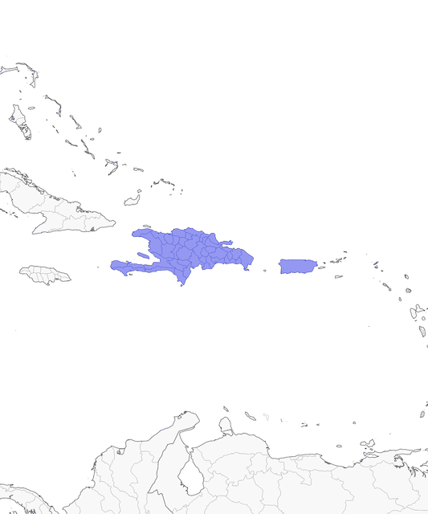
A species’ geographic range
Hispanolean Parrot
Tropical Resident
Dark-eyed Junco
N American short/med- distance migrant
Breeding
Year-round
Winter

Slide 15
A species’ geographic range
Hispanolean Parrot
Tropical Resident
Dark-eyed Junco
N American short/med- distance migrant
Breeding
Year-round
Winter

Slide 16
A species’ geographic range
Hispanolean Parrot
Tropical Resident
Dark-eyed Junco
N American short/med- distance migrant
Breeding
Year-round
Winter

Slide 17
A species’ geographic range
Hispanolean Parrot
Tropical Resident
Dark-eyed Junco
N American short/med- distance migrant
Breeding
Year-round
Winter

Slide 18
A species’ geographic range
Hispanolean Parrot
Tropical Resident
Dark-eyed Junco
N American short/med- distance migrant
Breeding
Year-round
Winter

Slide 19
A species’ geographic range
Hispanolean Parrot
Tropical Resident
Dark-eyed Junco
N American short/med- distance migrant
Breeding
Year-round
Winter

Slide 20
A species’ geographic range
Hispanolean Parrot
Tropical Resident
Dark-eyed Junco
N American short/med- distance migrant
Breeding
Year-round
Winter

Slide 21
A species’ geographic range
Hispanolean Parrot
Tropical Resident
Dark-eyed Junco
N American short/med- distance migrant
Breeding
Year-round
Winter

Slide 22
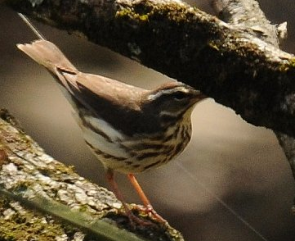
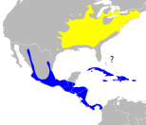
A species’ geographic range
Louisianna Waterthrush
Long-distance Neotropical migrant

Slide 23
A species’ geographic range
Louisianna Waterthrush
Long-distance Neotropical migrant

Slide 24
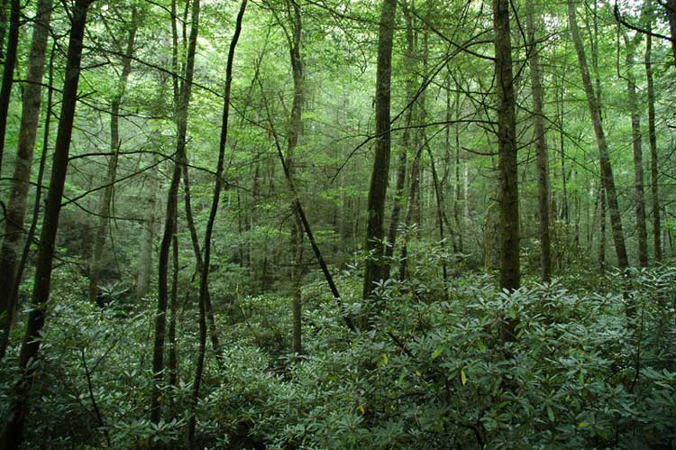
2) Bird Habitat

Slide 25
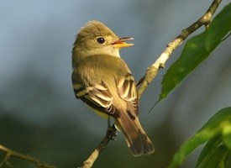
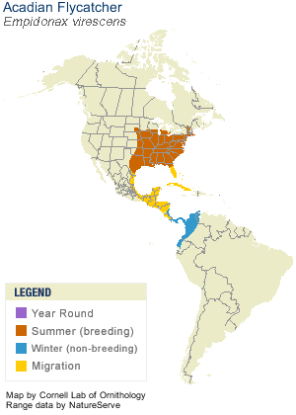
Bird Habitat
Summer habitat
Breeding habitat
Nesting Habitat

Slide 26
Bird Habitat
Summer habitat
Breeding habitat
Nesting Habitat

Slide 27
Bird Habitat
Summer habitat
Breeding habitat
Nesting Habitat

Slide 28
Bird Habitat
Summer habitat
Breeding habitat
Nesting Habitat

Slide 29
Bird Habitat
Summer habitat
Breeding habitat
Nesting Habitat
Where it builds its nest

Slide 30
Bird Habitat
Summer habitat
What kind of habitat surrounds where it nests; Where it forages while nesting
Breeding habitat
Nesting Habitat
Where it builds its nest

Slide 31
Bird Habitat
Habitat used before & after breeding
Summer habitat
What kind of habitat surrounds where it nests; Where it forages while nesting
Breeding habitat
Nesting Habitat
Where it builds its nest

Slide 32
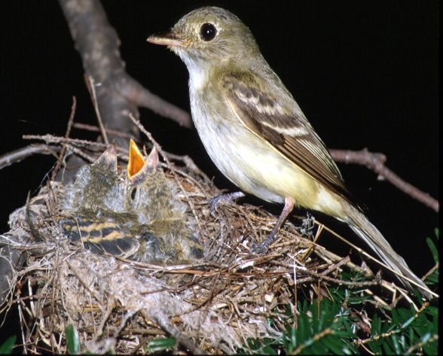
Bird Habitat
Summer habitat
Breeding habitat
Nesting Habitat
Notes:
See work by Scott Stohlson in Auk about use of edge habitats; also general research on habitat use differences between nesting & fledglings

Slide 33
Bird Habitat
Summer habitat
Breeding habitat
Nesting Habitat
Often in the branches of Hemlock trees, which are often on streams
Notes:
See work by Scott Stohlson in Auk about use of edge habitats; also general research on habitat use differences between nesting & fledglings

Slide 34
Bird Habitat
Summer habitat
Interiors of Large forests, usually with streams
Breeding habitat
Nesting Habitat
Often in the branches of Hemlock trees, which are often on streams
Notes:
See work by Scott Stohlson in Auk about use of edge habitats; also general research on habitat use differences between nesting & fledglings

Slide 35
Bird Habitat
Probably includes edges of forests
Summer habitat
Interiors of Large forests, usually with streams
Breeding habitat
Nesting Habitat
Often in the branches of Hemlock trees, which are often on streams
Notes:
See work by Scott Stohlson in Auk about use of edge habitats; also general research on habitat use differences between nesting & fledglings

Slide 36
Bird Habitat
Summer habitat
Breeding habitat
Species are often very specific about where they breed in the summer…
Nesting Habitat
Wintering Habitat

Slide 37
Bird Habitat
Summer habitat
Breeding habitat
Species are often very specific about where they breed in the summer…
Nesting Habitat
Wintering Habitat
…& also where they spend the winter!

Slide 38
Bird Habitat
Breeding
Migratory stopover
Winter

Slide 39
Bird Habitat
Breeding
Migratory stopover
Winter

Slide 40
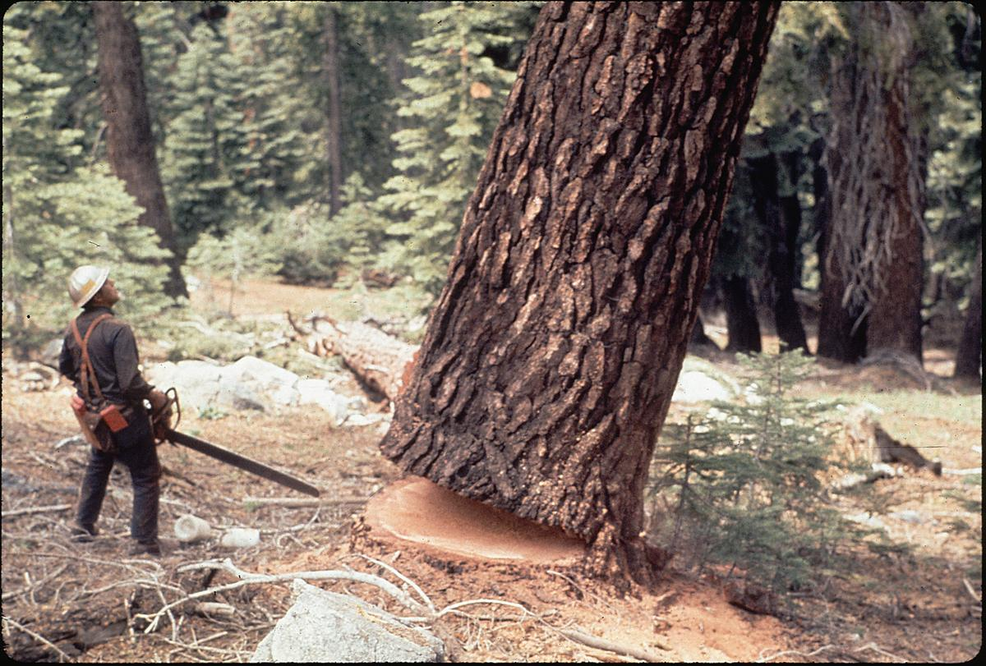
3) Damage to bird habitat:

Slide 41
Damage to Bird Habitat
Degradation
Fragmentation
Loss
Reduction in the quality of habitat
-More predators
-Fewer resources
-Can occur w/o obvious changes to the structure of habitat
Reduction in the size, connectivity, or integrity of habitat
-Forest divided into smaller patches by logging
-Roads in forest
Reduction in the amount or extant of habitat, often by harvest or conversion to another l& use
-Forest logged for timber & then converted to farm

Slide 42
Damage to Bird Habitat
Degradation
Fragmentation
Loss
Reduction in the quality of habitat
-More predators
-Fewer resources
-Can occur w/o obvious changes to the structure of habitat
Reduction in the size, connectivity, or integrity of habitat
-Forest divided into smaller patches by logging
-Roads in forest
Reduction in the amount or extant of habitat, often by harvest or conversion to another l& use
-Forest logged for timber & then converted to farm

Slide 43
Damage to Bird Habitat
Degradation
Fragmentation
Loss
Reduction in the quality of habitat
Makes it less hospitable.
-More predators
-Fewer resources
-Can occur w/o obvious changes to the structure of habitat
Reduction in the size, connectivity, or integrity of habitat
-Forest divided into smaller patches by logging
-Roads in forest
Reduction in the amount or extant of habitat, often by harvest or conversion to another l& use
-Forest logged for timber & then converted to farm

Slide 44
Damage to Bird Habitat
Degradation
Fragmentation
Loss
Reduction in the quality of habitat
Makes it less hospitable.
-More predators
-Fewer resources
-Can occur w/o obvious changes to the structure of habitat
Reduction in the size, connectivity, or integrity of habitat
-Forest divided into smaller patches by logging
-Roads in forest
Reduction in the amount or extant of habitat, often by harvest or conversion to another l& use
-Forest logged for timber & then converted to farm

Slide 45
Damage to Bird Habitat
Degradation
Fragmentation
Loss
Reduction in the quality of habitat
Makes it less hospitable.
-More predators
-Fewer resources
-Can occur w/o obvious changes to the structure of habitat
Reduction in the size, connectivity, or integrity of habitat
-Forest divided into smaller patches by logging
-Roads in forest
Reduction in the amount or extant of habitat, often by harvest or conversion to another l& use
-Forest logged for timber & then converted to farm

Slide 46
Damage to Bird Habitat
Degradation
Fragmentation
Loss
Reduction in the quality of habitat
Makes it less hospitable.
-More predators
-Fewer resources
-Can occur w/o obvious changes to the structure of habitat
Reduction in the size, connectivity, or integrity of habitat
-Forest divided into smaller patches by logging
-Roads in forest
Reduction in the amount or extant of habitat, often by harvest or conversion to another l& use
-Forest logged for timber & then converted to farm

Slide 47
Damage to Bird Habitat
Degradation
Fragmentation
Loss
Reduction in the quality of habitat
Makes it less hospitable.
-More predators
-Fewer resources
-Can occur w/o obvious changes to the structure of habitat
Reduction in the size, connectivity, or integrity of habitat
-Forest divided into smaller patches by logging
-Roads in forest
Reduction in the amount or extant of habitat, often by harvest or conversion to another l& use
-Forest logged for timber & then converted to farm

Slide 48

Damage to Bird Habitat
Degradation
Fragmentation
Loss
Reduction in the quality of habitat
Makes it less hospitable.
-More predators
-Fewer resources
-Can occur w/o obvious changes to the structure of habitat
Reduction in the size, connectivity, or integrity of habitat
-Forest divided into smaller patches by logging
-Roads in forest
Reduction in the amount or extant of habitat, often by harvest or conversion to another l& use
-Forest logged for timber & then converted to farm

Slide 49


Damage to Bird Habitat
Degradation
High quality stream
Acidic stream

Slide 50
Damage to Bird Habitat
Degradation
Reduction in the quality of habitat
High quality stream
Acidic stream

Slide 51
Damage to Bird Habitat
Degradation
Reduction in the quality of habitat
-More predators
-Fewer resources
-Can occur w/o obvious changes to the structure of habitat
High quality stream
Acidic stream

Slide 52

Damage to Bird Habitat
Fragmentation
Contiguous / In-tact forest
Forest fragments / patches
Forest Edge

Slide 53
Damage to Bird Habitat
Fragmentation
Contiguous / In-tact forest
Reduction in the size, connectivity, or integrity of habitat
Forest fragments / patches
Forest Edge

Slide 54
Damage to Bird Habitat
Fragmentation
Contiguous / In-tact forest
Reduction in the size, connectivity, or integrity of habitat
-Forest divided into smaller patches by logging
-Roads in forest
Forest fragments / patches
Forest Edge

Slide 55
Damage to Bird Habitat
Fragmentation
Contiguous / In-tact forest
Reduction in the size, connectivity, or integrity of habitat
-Forest divided into smaller patches by logging
-Roads in forest
Forest fragments / patches
Forest Edge

Slide 56
Damage to Bird Habitat
Fragmentation
Contiguous / In-tact forest
Reduction in the size, connectivity, or integrity of habitat
-Forest divided into smaller patches by logging
-Roads in forest
Forest fragments / patches
Forest Edge

Slide 57
Damage to Bird Habitat
Fragmentation
Contiguous / In-tact forest
Reduction in the size, connectivity, or integrity of habitat
-Forest divided into smaller patches by logging
-Roads in forest
Forest fragments / patches
Forest Edge

Slide 58
Forest fragmentation
Interior
Edge
Matrix
Gap
Edge
Forest fragments / patches

Slide 59
Forest fragmentation
Interior
Edge
Matrix
Gap
Edge
Forest fragments / patches

Slide 60
Forest fragmentation
Interior
Edge
Matrix
Gap
Edge
Forest fragments / patches

Slide 61
Forest fragmentation
Interior
Edge
Matrix
Gap
Edge
Forest fragments / patches

Slide 62


Forest fragmentation by roads

Slide 63

4) Bird Predators:

Slide 64



Predation on Birds
Nest predation
Predation “on the wing”
Eggs or
nestlings
Incubating female
Fledglings / Juveniles
Adults
Notes:
https://www.allaboutbirds.org/how-can-i-protect-the-baby-birds-in-a-nest-from-predatory-birds-&-other-predators-like-snakes-&-cats/

Slide 65
Predation on Birds
Nest predation
Predation “on the wing”
Eggs or
nestlings
Incubating female
Fledglings / Juveniles
Adults
Notes:
https://www.allaboutbirds.org/how-can-i-protect-the-baby-birds-in-a-nest-from-predatory-birds-&-other-predators-like-snakes-&-cats/

Slide 66
Predation on Birds
Nest predation
Predation “on the wing”
Eggs or
nestlings
Incubating female
Fledglings / Juveniles
Adults
Camera trap
Raptor vs pigeon?
Nest box
Notes:
https://www.allaboutbirds.org/how-can-i-protect-the-baby-birds-in-a-nest-from-predatory-birds-&-other-predators-like-snakes-&-cats/

Slide 67
Predation on Birds
Nest predation
Predation “on the wing”
Eggs or
nestlings
Incubating female
Fledglings / Juveniles
Adults
Camera trap
Raptor vs pigeon?
Nest box
Notes:
https://www.allaboutbirds.org/how-can-i-protect-the-baby-birds-in-a-nest-from-predatory-birds-&-other-predators-like-snakes-&-cats/

Slide 68
Predation on Birds
Nest predation
Predation “on the wing”
Eggs or
nestlings
Incubating female
Fledglings / Juveniles
Adults
Camera trap
Raptor vs pigeon?
Nest box
Notes:
https://www.allaboutbirds.org/how-can-i-protect-the-baby-birds-in-a-nest-from-predatory-birds-&-other-predators-like-snakes-&-cats/

Slide 69
Predation on Birds
Nest predation
Predation “on the wing”
Eggs or
nestlings
Incubating female
Fledglings / Juveniles
Adults
Camera trap
Raptor vs pigeon?
Nest box
Notes:
https://www.allaboutbirds.org/how-can-i-protect-the-baby-birds-in-a-nest-from-predatory-birds-&-other-predators-like-snakes-&-cats/

Slide 70
Predation on Birds
Nest predation
Predation “on the wing”
Eggs or
nestlings
Incubating female
Fledglings / Juveniles
Adults
Camera trap
Raptor vs pigeon?
Nest box
Notes:
https://www.allaboutbirds.org/how-can-i-protect-the-baby-birds-in-a-nest-from-predatory-birds-&-other-predators-like-snakes-&-cats/

Slide 71



Nest predation
Bear
Mice?
Snakes Raccoons
Mice Cats
Other birds (!)
Deer (!) Bears (!!)
Raccoons
Notes:
http://www.mirror.co.uk/news/world-news/watch-bear-climb-electricity-pylon-5832795

Slide 72


Slide 73


Slide 74


Predation “on the wing”
Adults
Fledglings / Juveniles

Slide 75
Predation “on the wing”
Adults
Fledglings / Juveniles
Young birds <1 month old not good at flying

Slide 76


Predation “on the wing”

Slide 77

Nest predation & Habitat fragmentation
swift parrot
Sugar glider
Notes:
Sugar Glider
Figure 2: A sugar glider predation event captured by a camera trap at Region 2. The panel shows (a) an adult female swift parrot at her nest cavity at 1900 h, then (b) at 2300 h on the same day, a sugar glider entering the cavity, where it caused the failure of that nest. (c) Adult female swift parrots are killed & eaten by sugar gliders.

Slide 78


Fragmented
Notes:
Figure 3 Modelled daily survival rates (95% confidence
intervals) of mainl& Tasmanian swift parrot nests as a
function of l&scape-scale forest cover. Estimates were
generated using the parameters from the model of best fit &
show that DSR improved as regional forest cover increased. In
contrast, DSR was 1 for nests on isl&s where sugar gliders do
not occur (not illustrated). DSR, daily survival rate.

Slide 79
Contiguous
(Not Fragmented)
Fragmented
Notes:
Figure 3 Modelled daily survival rates (95% confidence
intervals) of mainl& Tasmanian swift parrot nests as a
function of l&scape-scale forest cover. Estimates were
generated using the parameters from the model of best fit &
show that DSR improved as regional forest cover increased. In
contrast, DSR was 1 for nests on isl&s where sugar gliders do
not occur (not illustrated). DSR, daily survival rate.

Slide 80
7% of females eaten!
Contiguous
(Not Fragmented)
Fragmented
Notes:
Figure 3 Modelled daily survival rates (95% confidence
intervals) of mainl& Tasmanian swift parrot nests as a
function of l&scape-scale forest cover. Estimates were
generated using the parameters from the model of best fit &
show that DSR improved as regional forest cover increased. In
contrast, DSR was 1 for nests on isl&s where sugar gliders do
not occur (not illustrated). DSR, daily survival rate.

Slide 81
<1% eaten
7% of females eaten!
Contiguous
(Not Fragmented)
Fragmented
Notes:
Figure 3 Modelled daily survival rates (95% confidence
intervals) of mainl& Tasmanian swift parrot nests as a
function of l&scape-scale forest cover. Estimates were
generated using the parameters from the model of best fit &
show that DSR improved as regional forest cover increased. In
contrast, DSR was 1 for nests on isl&s where sugar gliders do
not occur (not illustrated). DSR, daily survival rate.

Slide 82

Introduced Predators

Slide 83


The feral cat “problem”

Slide 84


versus
Build them homes!
Get rid of them!

Slide 85
5) Bird diseases: Pathogens, Parasites & zooenotic transmission

Slide 86

Pathogens vs. Parasites (in Ecology)
Pathogens
Parasite
Cause disease…
Ecological usage:
The really small stuff:
viruses,
bacteria,
fungi
Cause disease…
Ecological usage
Big stuff: “brood parasites”
Birds that they their eggs in another spp. nests!
Small to medium-sized stuff
“macroparasites”
can see w/ naked eye
worms, lice, fleas
“microparasite” – malaria,

Slide 87
Pathogens vs. Parasites (in Ecology)
Pathogens
Parasite
Cause disease…
Ecological usage:
The really small stuff:
viruses,
bacteria,
fungi
Cause disease…
Ecological usage
Big stuff: “brood parasites”
Birds that they their eggs in another spp. nests!
Small to medium-sized stuff
“macroparasites”
can see w/ naked eye
worms, lice, fleas
“microparasite” – malaria,

Slide 88
Pathogens vs. Parasites (in Ecology)
Pathogens
Parasite
Cause “disease”…
Ecological usage:
The really small stuff:
viruses,
bacteria,
fungi
Cause “harm”…
Ecological usage
Big stuff: “brood parasites”
Birds that they their eggs in another spp. nests!
Small to medium-sized stuff
“macroparasites”
can see w/ naked eye
worms, lice, fleas
“microparasite” – malaria,

Slide 89



Bird parasites
Ectoparasites
(outside of cells)
Endoparasites
(inside of cells)
Intracellular
-malaria
Mites, Fleas
-feathers
-legs
Intercellular
-intestinal
worms
Botflies
-burrow into skin
(yuck)
Giardia
Notes:
https://en.wikipedia.org/wiki/Giardia#/media/File:Giardia_lamblia_SEM_8698_lores.jpg
https://microbiology.usgs.gov/image_gallery_other_microbes_giemsa_blood_smear.html
Giemsa-stained blood smear Photo credit: USGS
Research Summary: Changes in Prevalence of Avian Malaria on the Alaka`i Plateau, Kaua`i: an Early Signal for Global Warming? (Carter T. Atkinson)

Slide 90
Bird parasites
Ectoparasites
(outside of cells)
Endoparasites
(inside of cells)
Intracellular
-malaria
Mites, Fleas
-feathers
-legs
Intercellular
-intestinal
worms
Botflies
-burrow into skin
(yuck)
Giardia
Notes:
https://en.wikipedia.org/wiki/Giardia#/media/File:Giardia_lamblia_SEM_8698_lores.jpg
https://microbiology.usgs.gov/image_gallery_other_microbes_giemsa_blood_smear.html
Giemsa-stained blood smear Photo credit: USGS
Research Summary: Changes in Prevalence of Avian Malaria on the Alaka`i Plateau, Kaua`i: an Early Signal for Global Warming? (Carter T. Atkinson)

Slide 91
Bird parasites
Ectoparasites
(outside of cells)
Endoparasites
(inside of cells)
Intracellular
-malaria
Mites, Fleas
-feathers
-legs
Intercellular
-intestinal
worms
Botflies
-burrow into skin
(yuck)
Giardia
Notes:
https://en.wikipedia.org/wiki/Giardia#/media/File:Giardia_lamblia_SEM_8698_lores.jpg
https://microbiology.usgs.gov/image_gallery_other_microbes_giemsa_blood_smear.html
Giemsa-stained blood smear Photo credit: USGS
Research Summary: Changes in Prevalence of Avian Malaria on the Alaka`i Plateau, Kaua`i: an Early Signal for Global Warming? (Carter T. Atkinson)

Slide 92
Bird parasites
Ectoparasites
(outside of cells)
Endoparasites
(inside of cells)
Intracellular
-malaria
Mites, Fleas
-feathers
-legs
Intercellular
-intestinal
worms
Botflies
-burrow into skin
(yuck)
Giardia
Notes:
https://en.wikipedia.org/wiki/Giardia#/media/File:Giardia_lamblia_SEM_8698_lores.jpg
https://microbiology.usgs.gov/image_gallery_other_microbes_giemsa_blood_smear.html
Giemsa-stained blood smear Photo credit: USGS
Research Summary: Changes in Prevalence of Avian Malaria on the Alaka`i Plateau, Kaua`i: an Early Signal for Global Warming? (Carter T. Atkinson)

Slide 93
Bird parasites
Ectoparasites
(outside of cells)
Endoparasites
(inside of cells)
Intracellular
-malaria
Mites, Fleas
-feathers
-legs
Intercellular
-intestinal
worms
Botflies
-burrow into skin
(yuck)
Giardia
Notes:
https://en.wikipedia.org/wiki/Giardia#/media/File:Giardia_lamblia_SEM_8698_lores.jpg
https://microbiology.usgs.gov/image_gallery_other_microbes_giemsa_blood_smear.html
Giemsa-stained blood smear Photo credit: USGS
Research Summary: Changes in Prevalence of Avian Malaria on the Alaka`i Plateau, Kaua`i: an Early Signal for Global Warming? (Carter T. Atkinson)

Slide 94
Bird parasites
Ectoparasites
(outside of cells)
Endoparasites
(inside of cells)
Intracellular
-malaria
Mites, Fleas
-feathers
-legs
Intercellular
-intestinal
worms
Botflies
-burrow into skin
(yuck)
Giardia
Notes:
https://en.wikipedia.org/wiki/Giardia#/media/File:Giardia_lamblia_SEM_8698_lores.jpg
https://microbiology.usgs.gov/image_gallery_other_microbes_giemsa_blood_smear.html
Giemsa-stained blood smear Photo credit: USGS
Research Summary: Changes in Prevalence of Avian Malaria on the Alaka`i Plateau, Kaua`i: an Early Signal for Global Warming? (Carter T. Atkinson)

Slide 95



Known negative impacts of parasites
Palm warbler
Leg mites

Slide 96

Known negative impacts of parasites
No mites
Mites
Notes:
FIG. 1. Mean pectoral muscle scores (SE) of parasitized & nonparasitized Palm Warblers in two habitats (pine forest, desert thorn scrub) & three sampling periods (November, January, March). Birds were scored for pectoral muscle mass using a scale of 0–3 (0 = muscle concave & sternum prominent to 3 = muscle convex & sternum not detectable).

Slide 97
Known negative impacts of parasites
Mites negative impact bird “body condition” as measured by “pectoral muscle score”
No mites
Mites
Notes:
FIG. 1. Mean pectoral muscle scores (SE) of parasitized & nonparasitized Palm Warblers in two habitats (pine forest, desert thorn scrub) & three sampling periods (November, January, March). Birds were scored for pectoral muscle mass using a scale of 0–3 (0 = muscle concave & sternum prominent to 3 = muscle convex & sternum not detectable).

Slide 98
Known negative impacts of parasites
Mites negative impact bird “body condition” as measured by “pectoral muscle score”
No mites
Mites
Notes:
FIG. 1. Mean pectoral muscle scores (SE) of parasitized & nonparasitized Palm Warblers in two habitats (pine forest, desert thorn scrub) & three sampling periods (November, January, March). Birds were scored for pectoral muscle mass using a scale of 0–3 (0 = muscle concave & sternum prominent to 3 = muscle convex & sternum not detectable).

Slide 99


Avian Zooenoses:
diseases transmitted from birds to humans
Bird flu
West Nile Virus

Slide 100
Avian Zooenoses:
diseases transmitted from birds to humans
Bird flu
West Nile Virus

Slide 101
Avian Zooenoses:
diseases transmitted from birds to humans
Bird flu
West Nile Virus

Slide 102
Avian Zooenoses:
diseases transmitted from birds to humans
Bird flu
West Nile Virus

Slide 103
Do most parasites have negative impacts on their avian hosts??
Macroparasites
Microparasite
Mites, fleas, ticks, worms
Often have negative effects
Eg Malaria
Often no negative effects found

Slide 104
Are the impacts of microparasites hard to identify?
?
Does parasite infection change ecology processes like predation?

Slide 105

Avian Malaria and Climate Change

Slide 106

Avian blood parasites
Malaria – via mosquitoes & midges
Leucocytozoon – black flies
Atoxoplasma - feces
Trypanosoma – blood feeding arthropods
Microfilaria (parasitic nematodes) - blood feeding arthropods

Slide 107

Avian Malaria
Kingdom Protista:
amoebas, flagellates, ciliates, or sporozoans
Phylum Apicomplexa
(class Haemosporidia, family Plasmoiidae)
Leucocytozoon (not technically “malaria”)
Birds
Plasmodium
Mammals, birds, reptiles
Plasmodium falciparum
Haemoproteus
Birds, reptiles, amphibians

Slide 108



Other protists
Flagellate
Giardia muris, a flagellate protozoan;
intestinal parasite in rodents, birds
& reptiles.
Amoeboid
A "giant amoeba", Chaos carolinense
Cilate
Blepharisma japonicum, ciliated protozoan.
https://en.wikipedia.org/wiki/Protozoa

Slide 109


Slide 110

Plasmodium vs. Haemoproteus
sci-books.org/biology/protozoan-parasites-of-domestic-animals-&-of-man/family-plasmodiidae-genus-haemoproteus.shtml
Haemoproteus

Slide 111

Life cycle of Plasmodium spp. From
Mahon & Manuselis, 2000.
http://medical-dictionary.thefreedictionary.com/Plasmodium+cathemerium

Slide 112


Plasmodium cathemerium
Northern cardinal
red-winged blackbird
great horned owl
house finch
blue jay
blue tit
wood thrush
song sparrow
northern mockingbird
cowbirds
house sparrow
magpies
bronze grackle
northern cardinal
canary
starling
house wren
robin
white-throated
sparrow
House sparrow

Slide 113


